Slide 1


Capstone Project - Price Prediction of Airbnb Housing
Jeevan Sai Sreella
OM75175
Under the guidance of
Prof. Chaojie Wang

Slide 2

Introduction
Determining the appropriate price for their property when listing on Airbnb poses a challenging task for Airbnb hosts.
Airbnb hosts must consider various features of their house and set a competitive price.
Choosing Airbnb based on price is challenging to customers due to the availability of numerous options.

Slide 3







Problem
s
Price
Location
No Easy Way Exists
This is an important concern for both customers and Airbnb hosts
Price varies with respect to location and neighbourhood areas
It is not always easy to fix a price for Airbnb hosts

Slide 4

Solution
Save Money
For customers when traveling
A web platform where users can provide the features and predict the price with the help of Machine learning model
Make Money
For Hosts when they list
Stay in Competition
Not too expensive also not too cheap

Slide 5
Project Lifecycle
Data Collection
Data Cleansing
Exploratory Data Analysis
Data insights and Visualization
Feature Engineering
Machine Learning model training
Results and Discussion
Web deployment of model

Slide 6

Data Collection & Data Cleansing
Web scraping from Airbnb.com is not allowed legally according to their privacy policy
Data is collected from third party website called Insideairbnb.com which collected data legally from Airbnb as of December 16, 2022
Airbnb listings data is collected from three locations: New York, Washington D.C & New Jersey
Removed null values, unwanted columns and filled the missing values with appropriate values and made ready for EDA phase

Slide 7

Exploratory Data Analysis
There are many categorical columns like Room type, Neighbourhood, Neighbourhood group and location e.t.c.,
Some Airbnb listings were discovered to have extremely high prices, while others had no prices listed.
Airbnb listings with zero price, which are hotels redirecting to their own websites, were identified as outliers and removed during model training.
The price distribution is skewed, so we applied logarithmic transformation to normalize it
Tableau was utilized for creating visualizations such as plots, graphs, and dashboards to obtain insights.

Slide 8
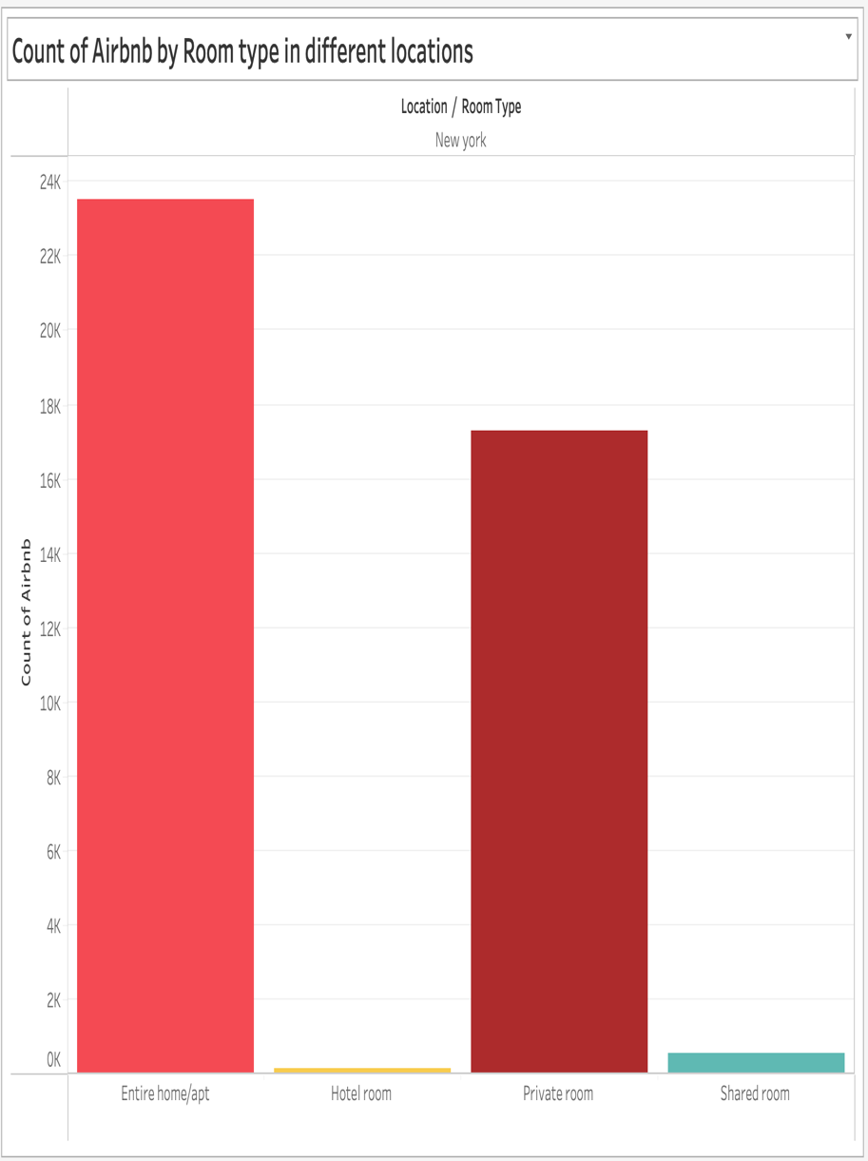
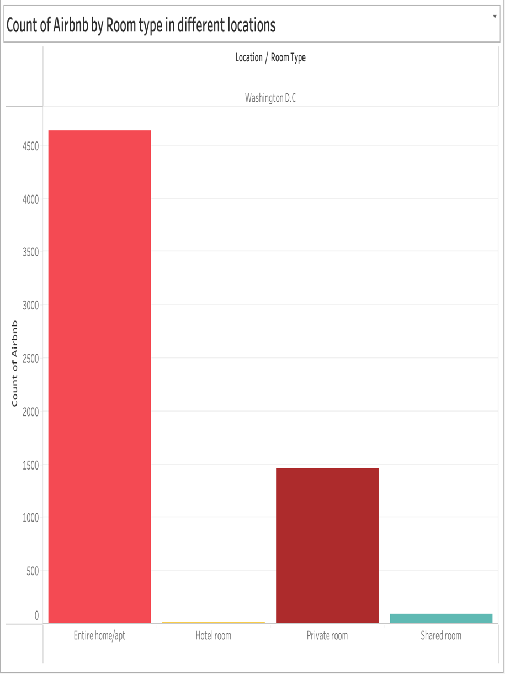
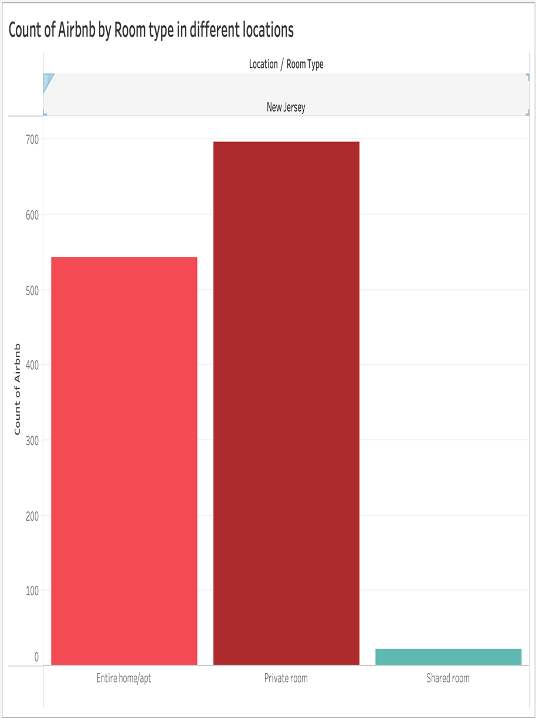
Data Insights & Visualization (Tableau)

Slide 9
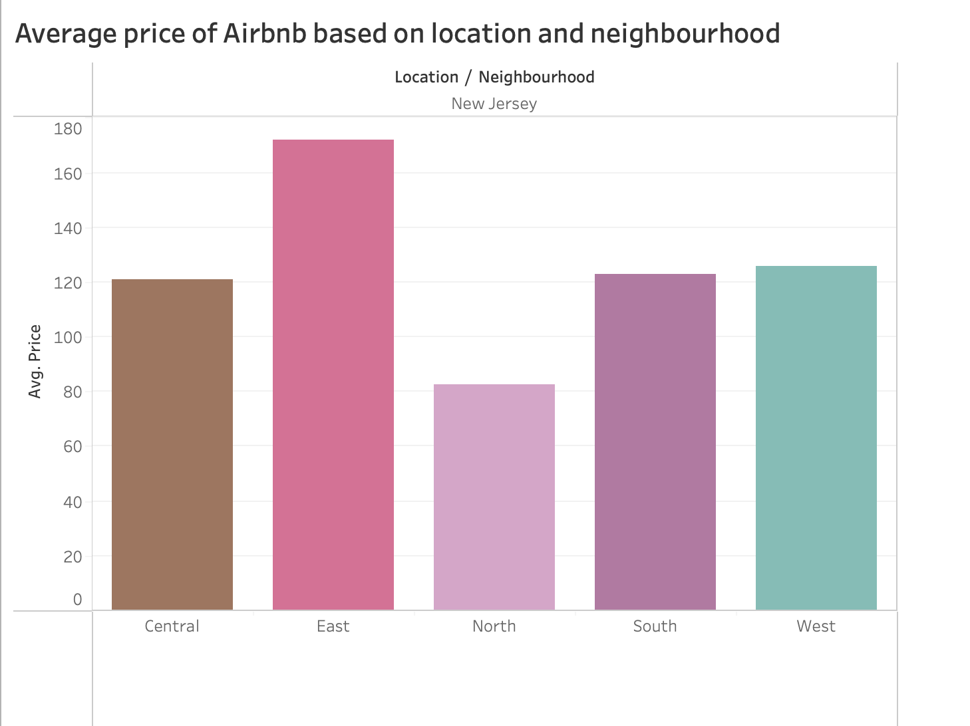

Slide 10
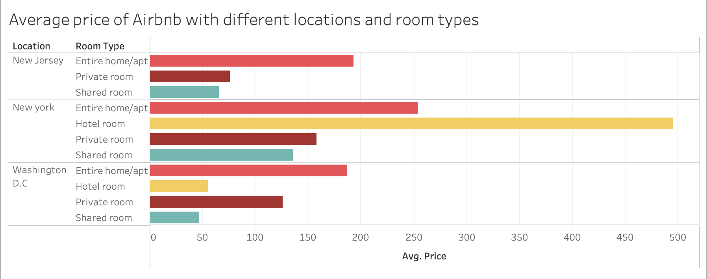

Slide 11
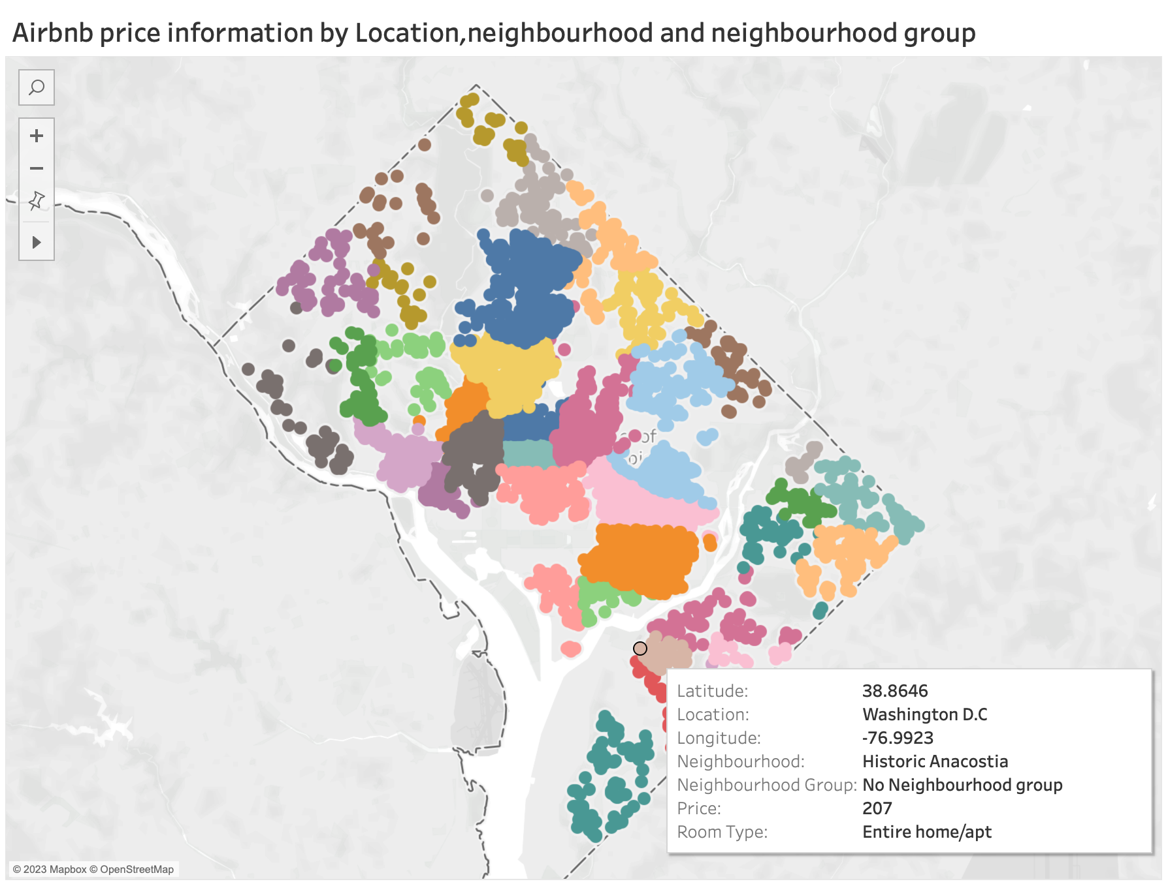

Slide 12
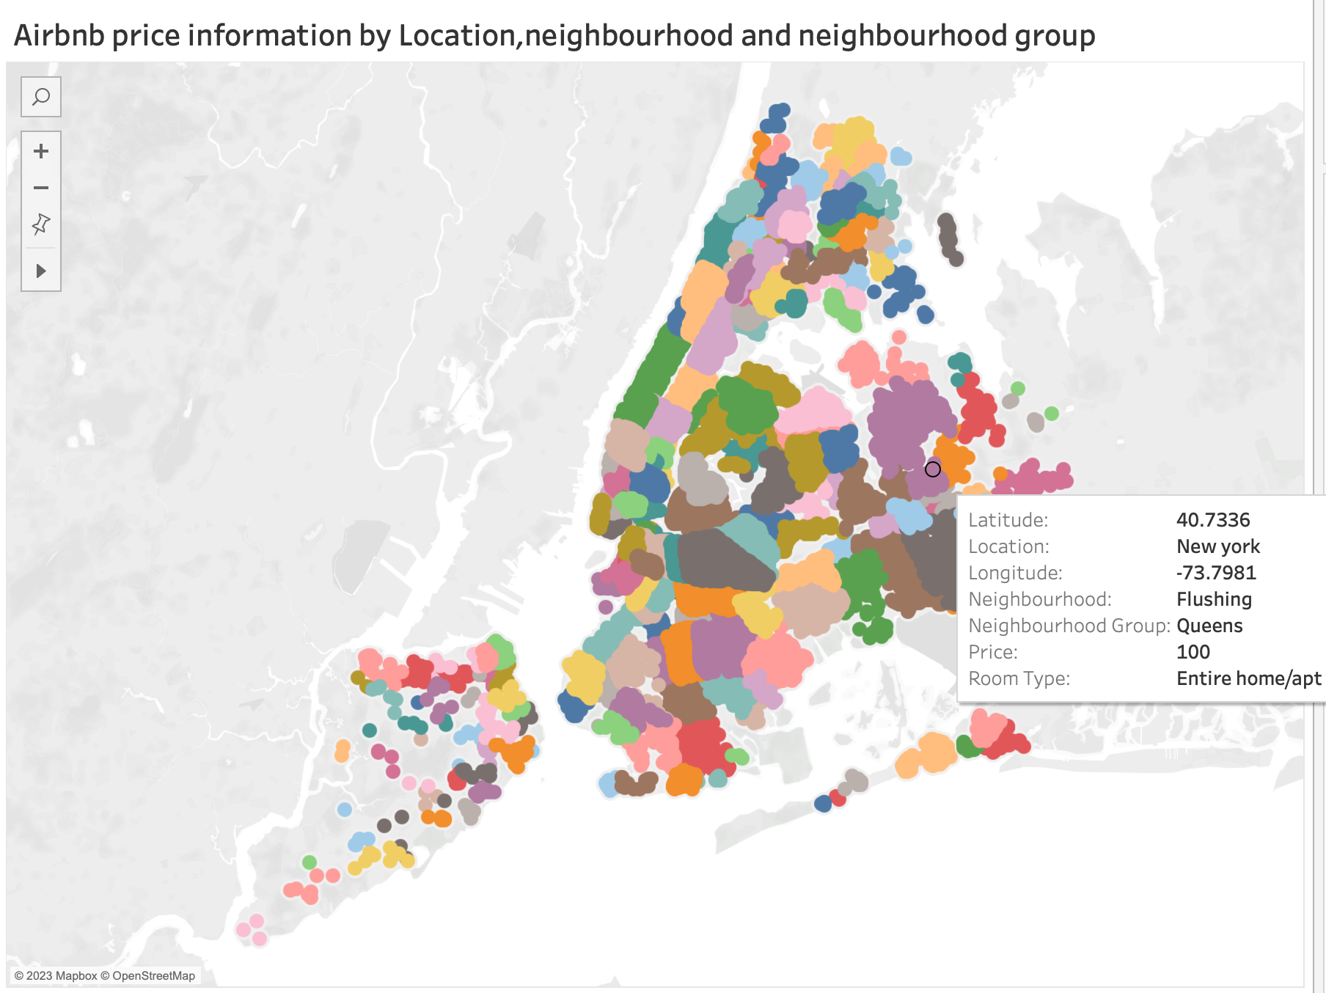

Slide 13
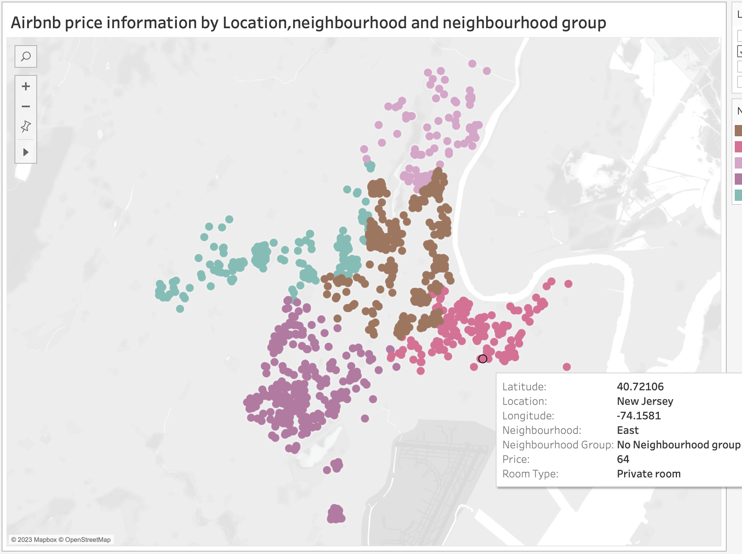

Slide 14
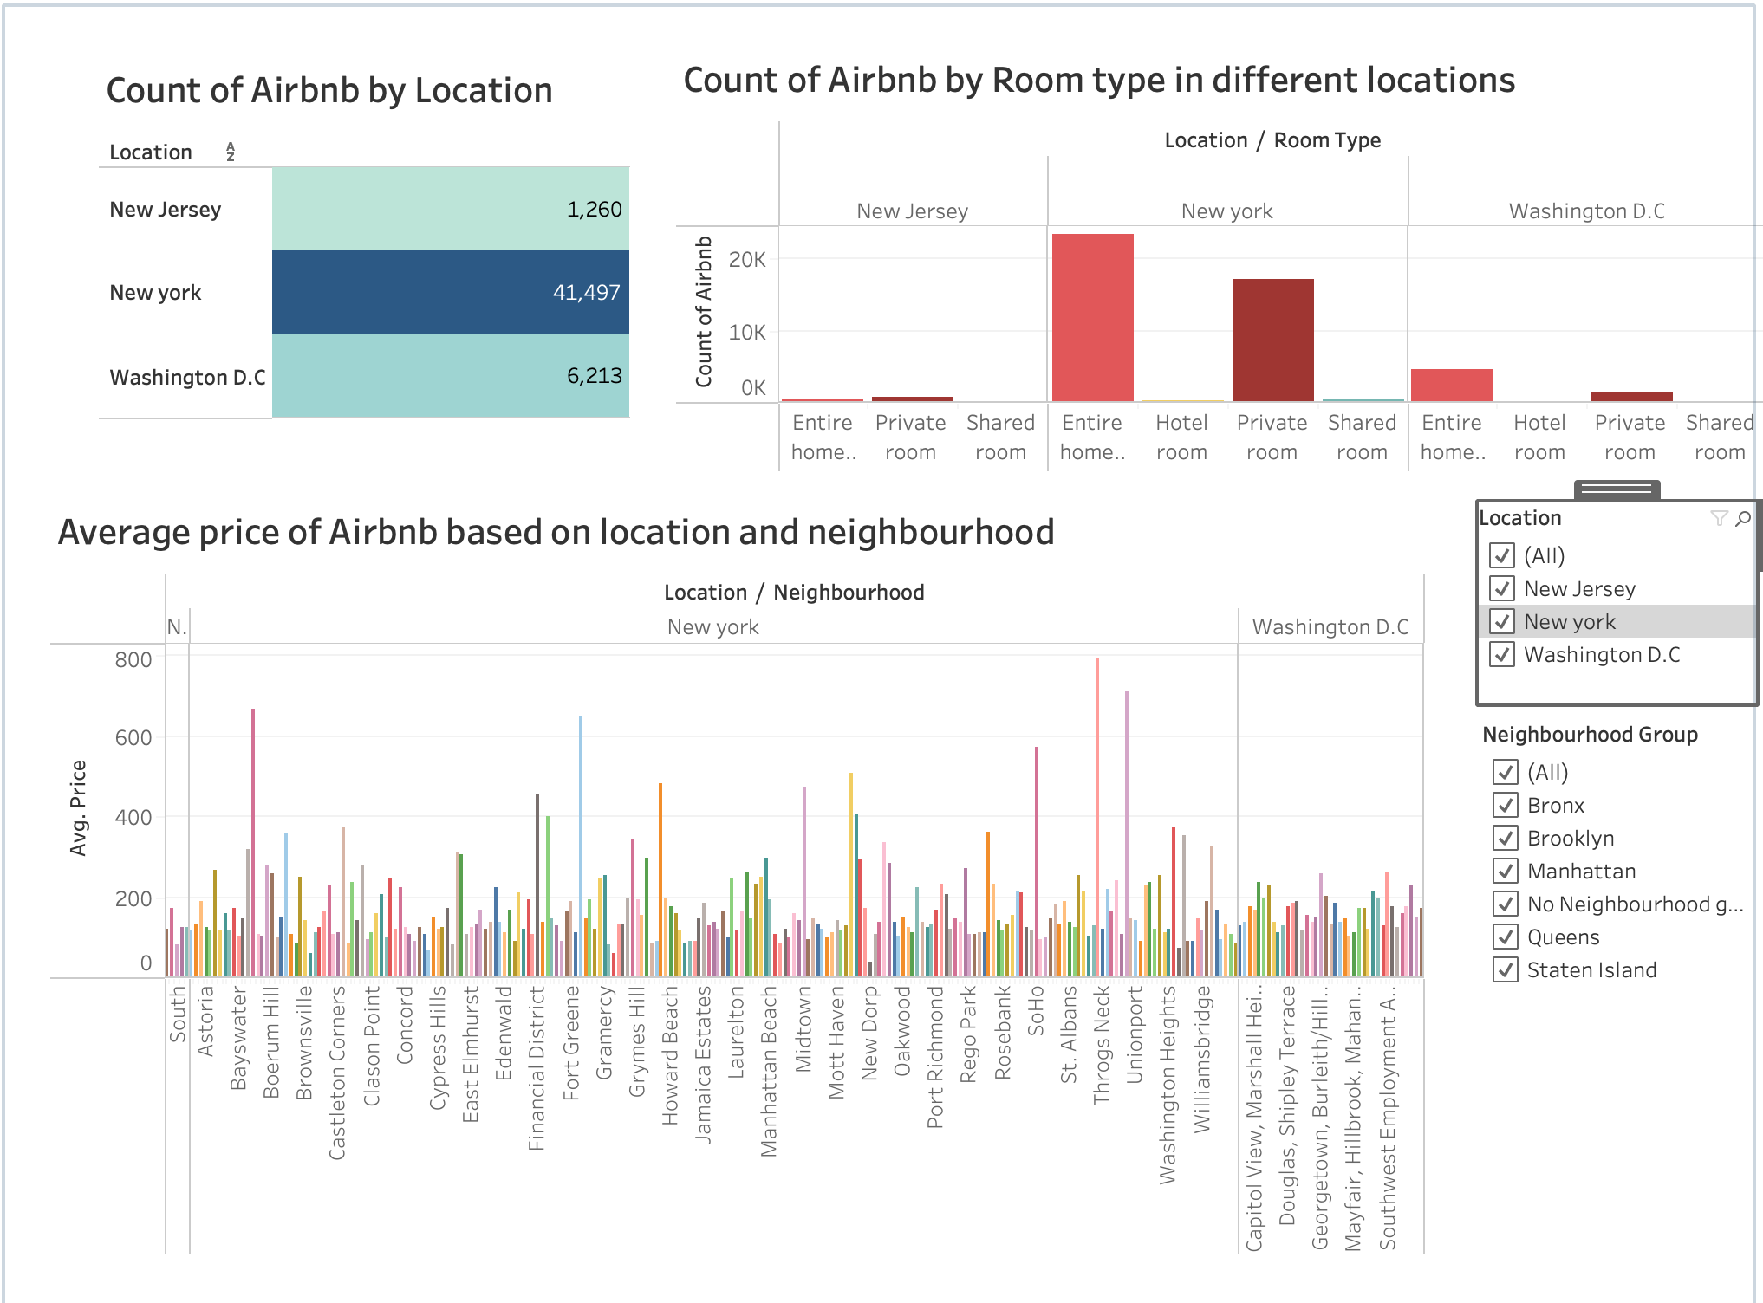

Slide 15

Feature Engineering & ML Model training
There are total 18 features and target variable ‘price’ in the dataset
There are few features like Id, Host Id and license which does not affect the target variable price.
Correlation matrix is used and selected features which are strongly correlated
Trained the model with different Machine learning algorithms like Linear Regression, Lasso and Ridge Regression, XGBoost Regression and Random forest regression
Linear Regression and Regularization algorithms gave less R2 value (0.49) which means more variance, but Random forest gave R2 score of 82%

Slide 16
Results and Discussion

Slide 17

Web deployment of Model
The trained model was saved as a pickle file, allowing for the passing of features to the file and the subsequent prediction of price.
Streamlit is a python-based web library to build front end application, and this is used for the web deployment of the model.
The web application allows users to input various features such as location, neighbourhood, and neighbourhood group. Additionally, users can select their exact location on the map and obtain the corresponding latitude and longitude values.
Additionally, users can input multiple features and click on the "Predict" button to obtain the predicted price

Slide 18






Advantages
Market Analysis
Increase Bookings
Benefit Host & Guests
Hosts can use market trends to determine the optimal price for their listing
By setting a reasonable price, hosts can potentially increase their revenue on Airbnb.
Both hosts and guests can use the model to predict a fair price threshold and make decisions accordingly.
Ease of Use
Real estate investors
Airbnb Company
Hosts or Guests can fill out features on web application and get the optimal price
This helps in investors to identify properties if they are undervalued or overvalued
This application can also be utilized by Airbnb to provide suggestions to hosts regarding adjusting prices in response to market competition.

Slide 19

Conclusion & Future Work
This project aimed to develop a machine learning model that could accurately predict the prices of Airbnb listings in three locations: NYC, NJ, and DC, using various features available in the dataset.
The web application assists hosts and guests in assessing their housing and Airbnb bookings.
There is potential for improving the model's accuracy by incorporating additional features, expanding to more locations, and gathering more data, among other possibilities.
Leveraging Natural Language processing on the Airbnb name and reviews will help in bringing more features and helps in model training and accuracy

Slide 20

THANK YOU!!

